Slide 1






Project Overview
Focus
Impact
Goal
Video Recognition and Classification Using Deep Learning
Create robust video classification system using deep learning.
Extract spatial and temporal features from videos.
Applications in surveillance, sports analytics, healthcare.

Slide 2

Problem Statement & Objective
Project Overview
Goal
Focus
Create robust video classification system using deep learning.
Extract spatial and temporal features from videos.
Impact
Applications in surveillance, sports analytics, healthcare.
Objective
Problem
Develop a CNN + RNN hybrid model.
Manual video analysis is slow and inefficient.
Videos contain spatial and temporal data complexities.
Accurate classification of video sequences.

Slide 3
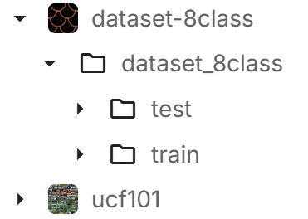

Dataset & Methodology
Dataset
Dataset used - UFC101
Labeled videos split into frames using OpenCV.
Preprocessing
Resize frames to 224x224
Problem Statement & Objective
Limit sequences to 20 frames
Methodology
Problem
Objective
Feature extraction via InceptionV3 transfer learning
Manual video analysis is slow and inefficient.
Develop a CNN + RNN hybrid model.
Temporal encoding and sequence modeling with RNN
Videos contain spatial and temporal data complexities.
Accurate classification of video sequences.

Slide 4

Model Architecture
Dataset & Methodology
Dataset
Frame-level feature extraction
Dataset used - UFC101
Labeled videos split into frames using OpenCV.
Temporal feature encoding
Preprocessing
Resize frames to 224x224
Limit sequences to 20 frames
Methodology
Sequence modeling of video frames
Feature extraction via InceptionV3 transfer learning
Temporal encoding and sequence modeling with RNN
ReLU and Softmax layers for output
CNN (InceptionV3)
StringLookup
Masking & GRU
Activation

Slide 5
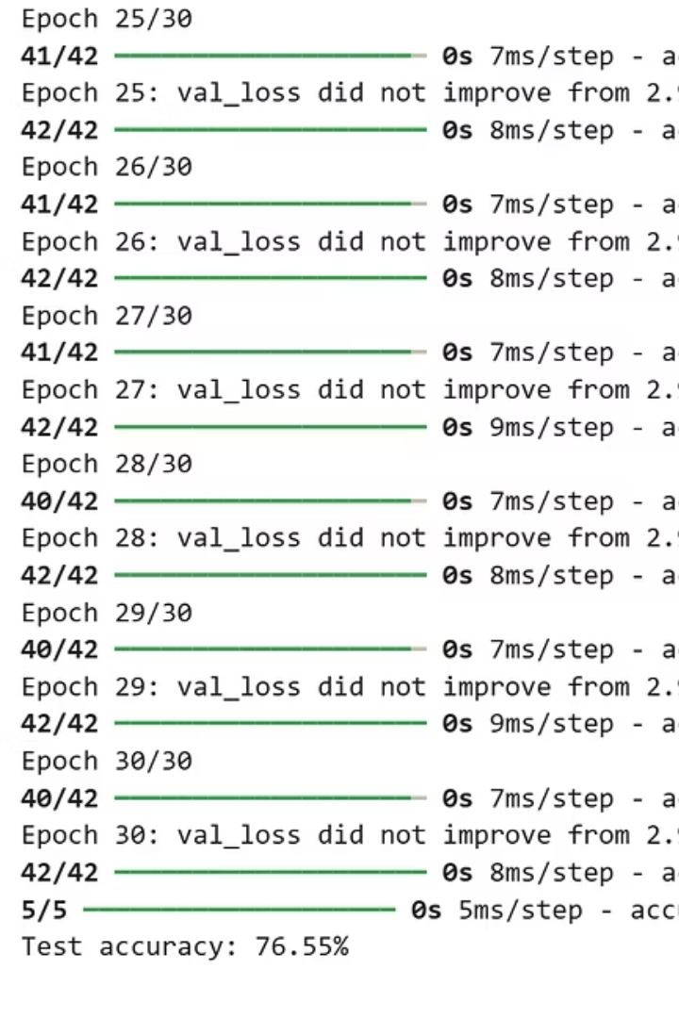
Evaluation
Training Parameters
Training and Testing
Model Architecture
CNN (InceptionV3)
Frame-level feature extraction
StringLookup
Temporal feature encoding
Masking & GRU
Sequence modeling of video frames
Activation
ReLU and Softmax layers for output
Validation split: 30%
Batch size: 64
Test accuracy: 76.55%
Epochs: 30
Image size: 224x224
Sequence length: 20

Slide 6




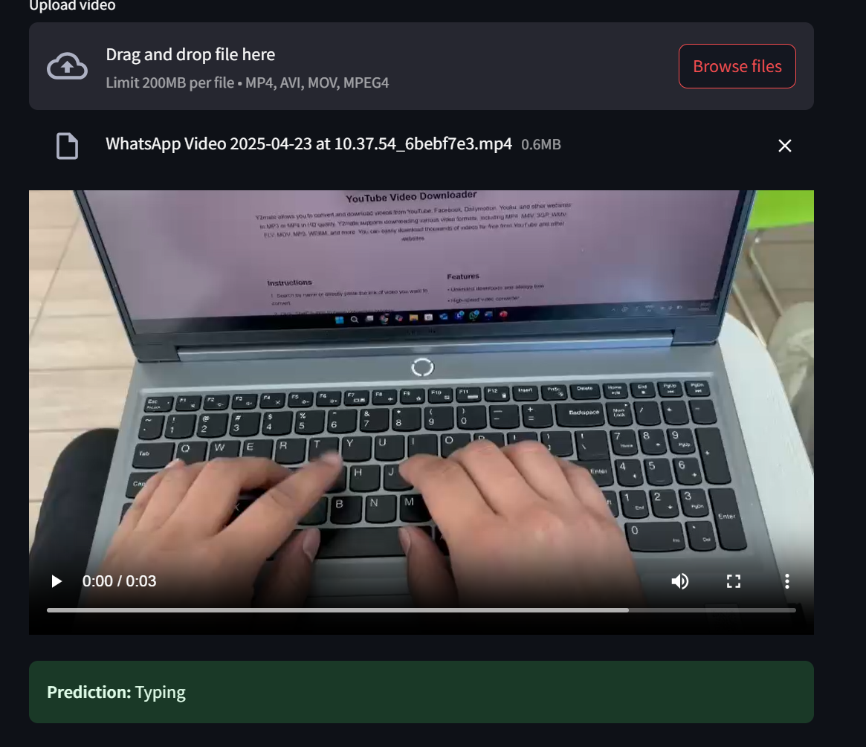
Results, Challenges & Conclusion
Challenges
Conclusion & Future Work
Results
Training and Testing
Training Parameters
Evaluation
Batch size: 64
Validation split: 30%
Epochs: 30
Test accuracy: 76.55%
Image size: 224x224
Sequence length: 20
Achieved 76.55% test accuracy.
Long sequences and memory limitations during training.
Explore real-time video streams, improve accuracy with attention mechanisms.

Slide 7
Results, Challenges & Conclusion
Results
Challenges
Achieved 76.55% test accuracy.
Long sequences and memory limitations during training.
Conclusion & Future Work
Explore real-time video streams, improve accuracy with attention mechanisms.

Slide 8


